Slide 1
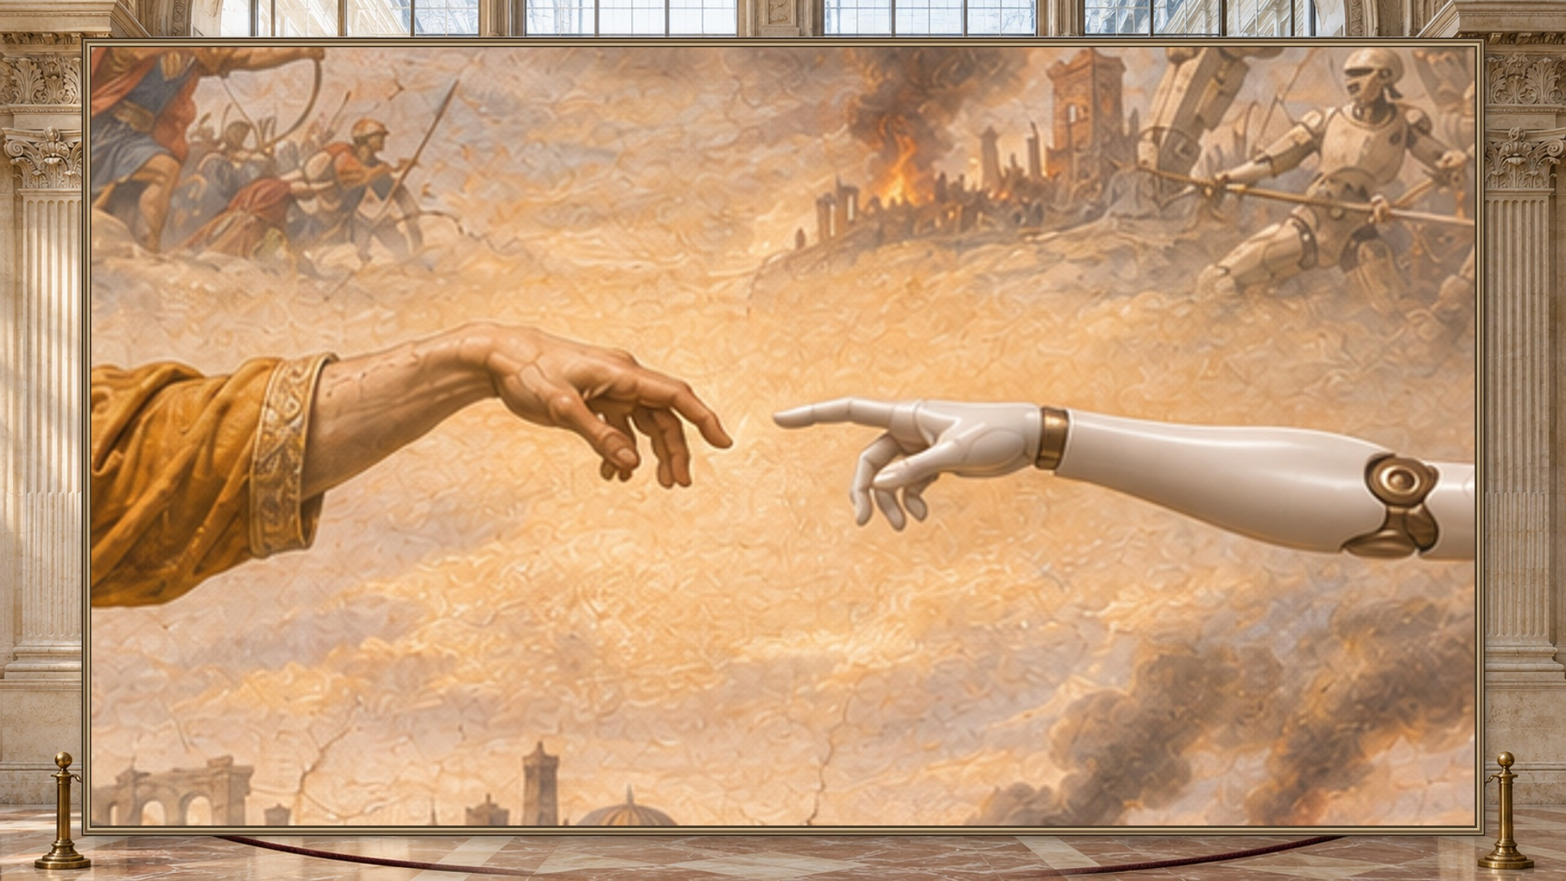
Notes:
[Play the reveal. Look up as the conflict comes into view.] How do we avoid that future?

Slide 2
“Hold my beer.”
The Human Touch
Notes:
[Slack cold open, if rehearsed: offer a handshake; the parked arm presents a fist. Switch, miss the greeting, then wave. This is a scripted bit. Skip it if the pose is not feature-locked.] Hold my beer. [Place the empty prop at the verified mark. Run the physical sequence live. Optional scripted voice, only if locked: “Say less.” Let the grip land.] Thanks.

Slide 3
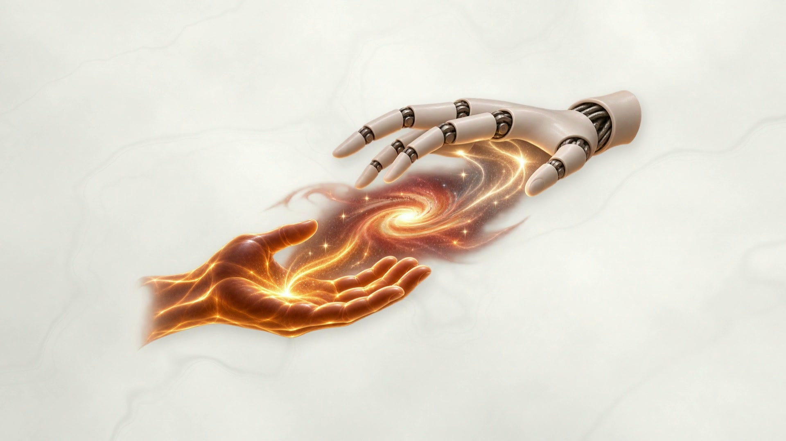

Slide 4
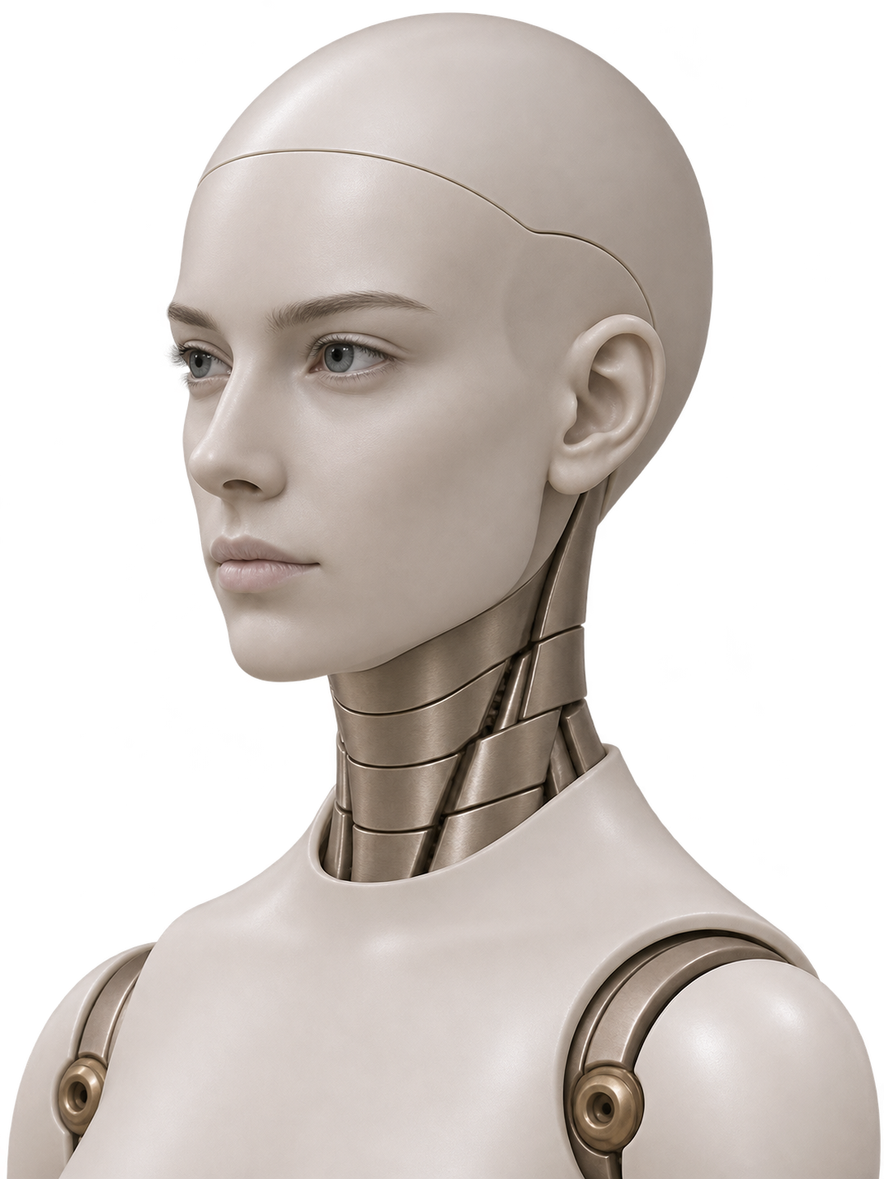
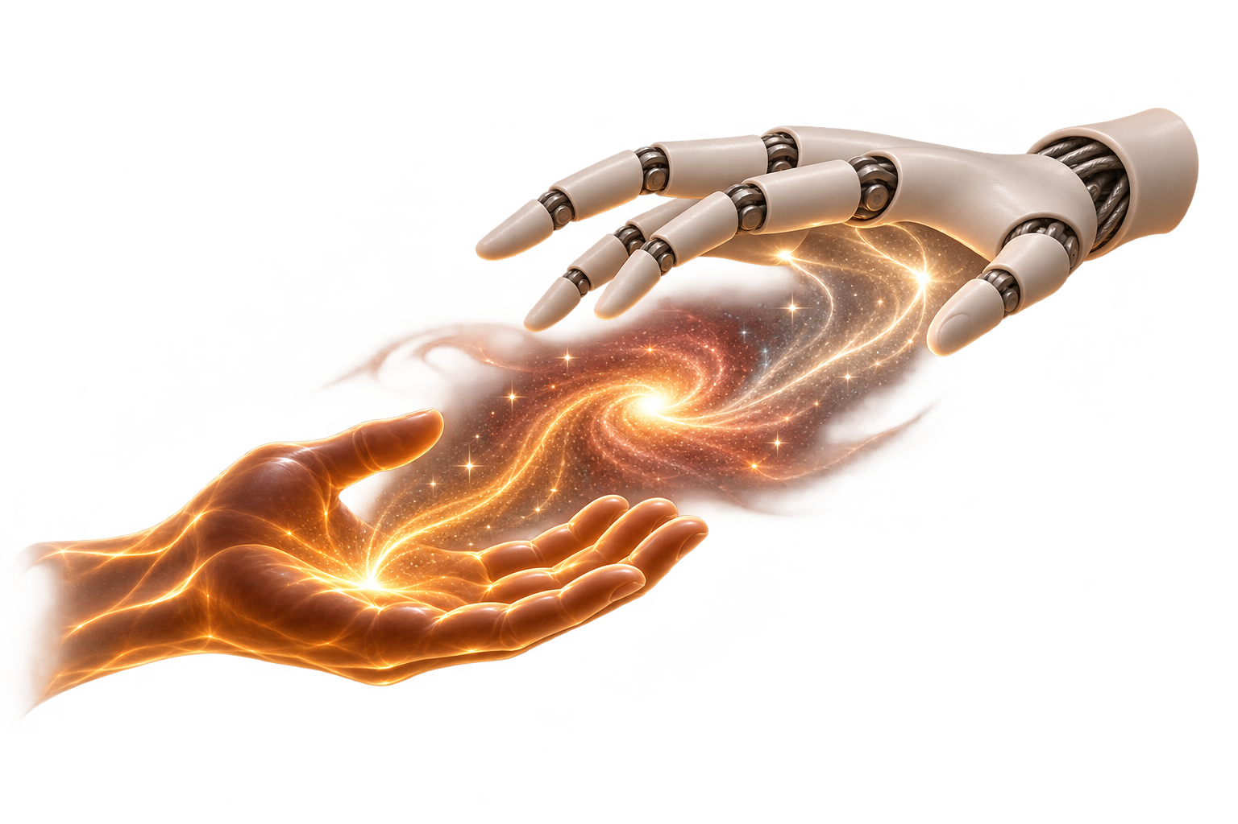
The
Human
Touch
Notes:
A can is easy to describe. The hard part is knowing what the person needs next. If I lift one end of a box, the useful place for a robot to be is at the other end. That’s what we mean by the human touch: two different actions that get one job done.

Slide 5
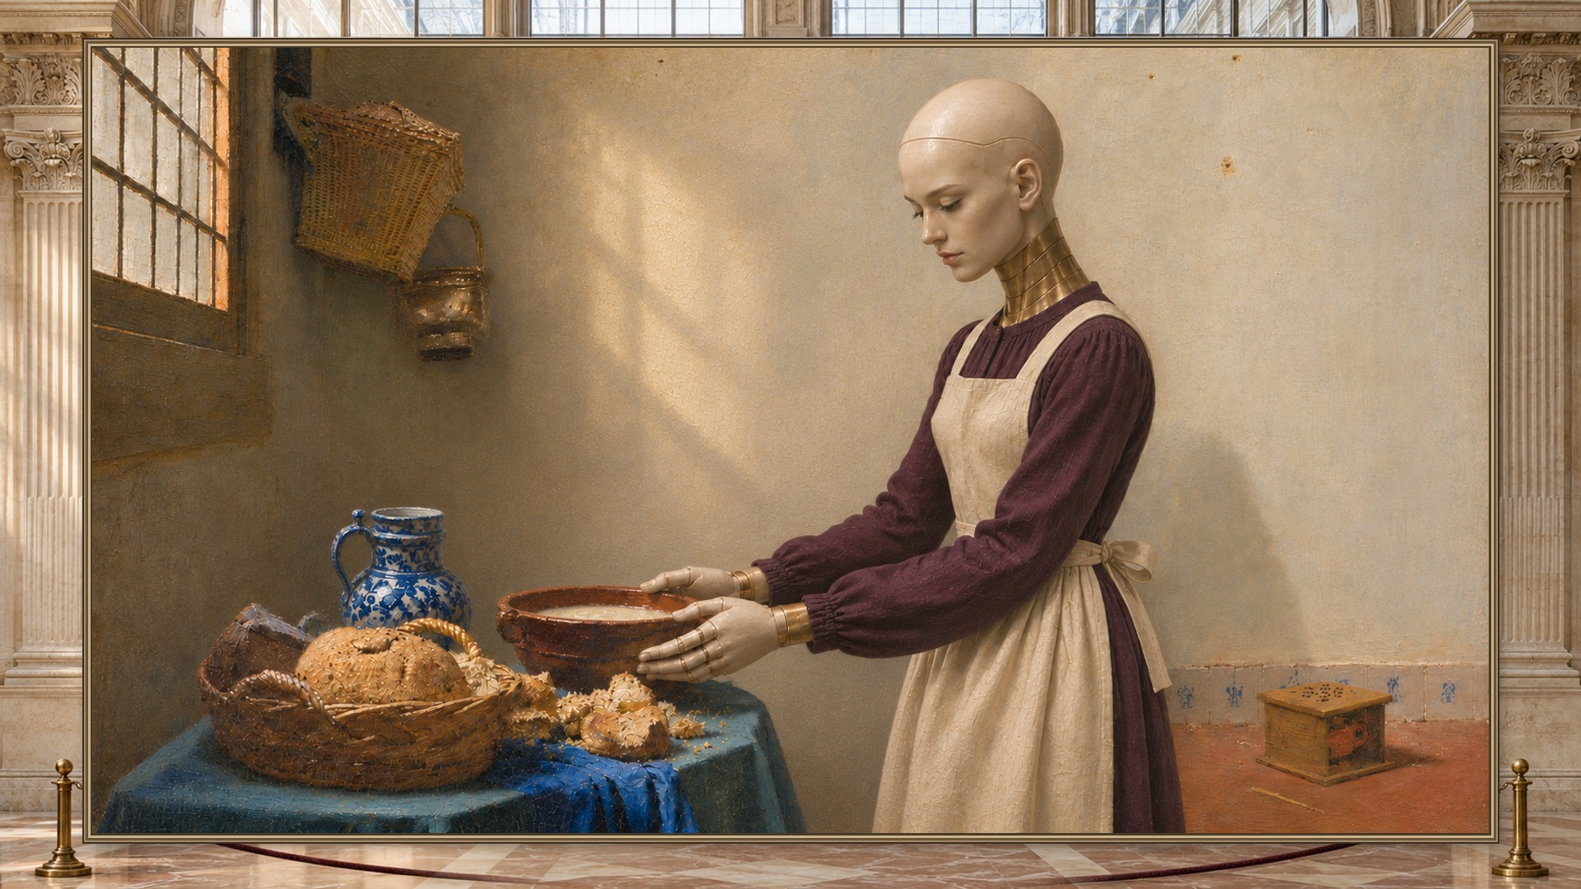
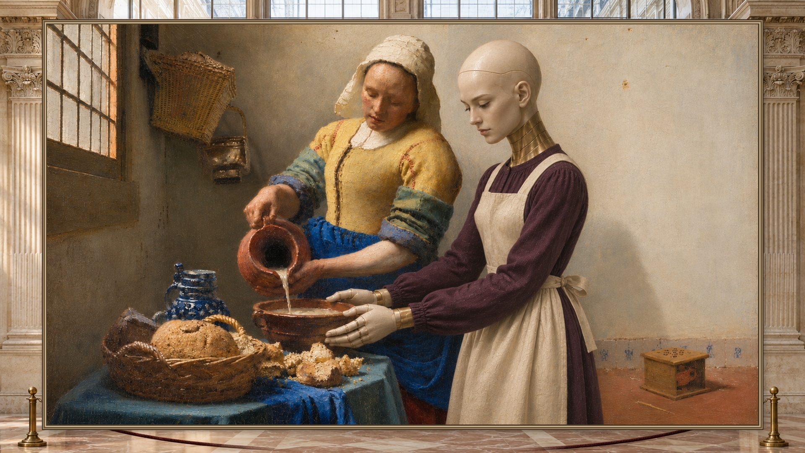
Who gives the cue?
Rehearsing alone
Rehearsing with a person
Notes:
A robotics team can make a thousand copies of a kitchen. Who tips the jug differently on the next run? Our idea is to let a real person enter each virtual scene, change the timing, and tell us whether the robot helped. The kitchen is simulated. The person making the decision is real.

Slide 6
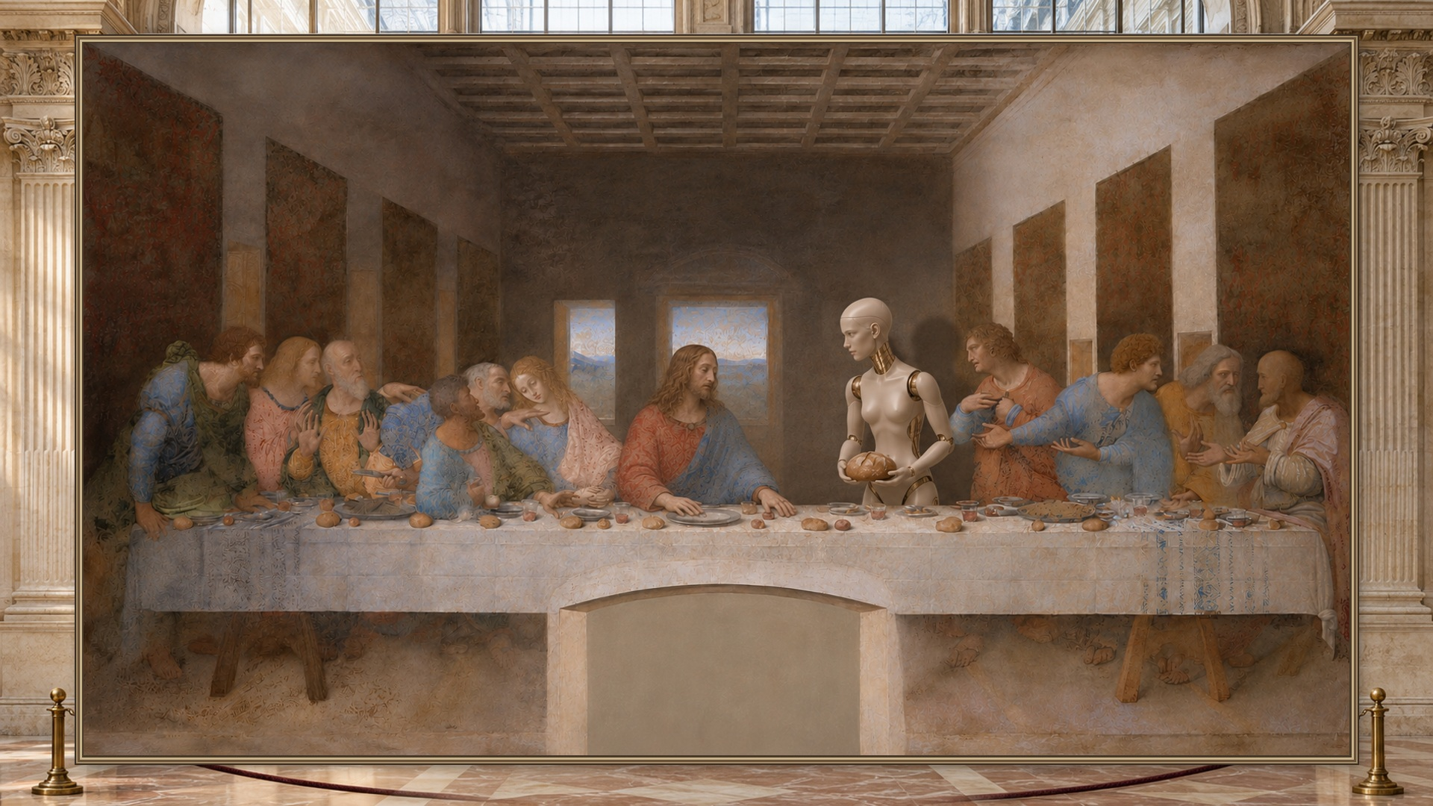
Notes:
Watch who reaches first. Emmy offers the loaf.

Slide 7
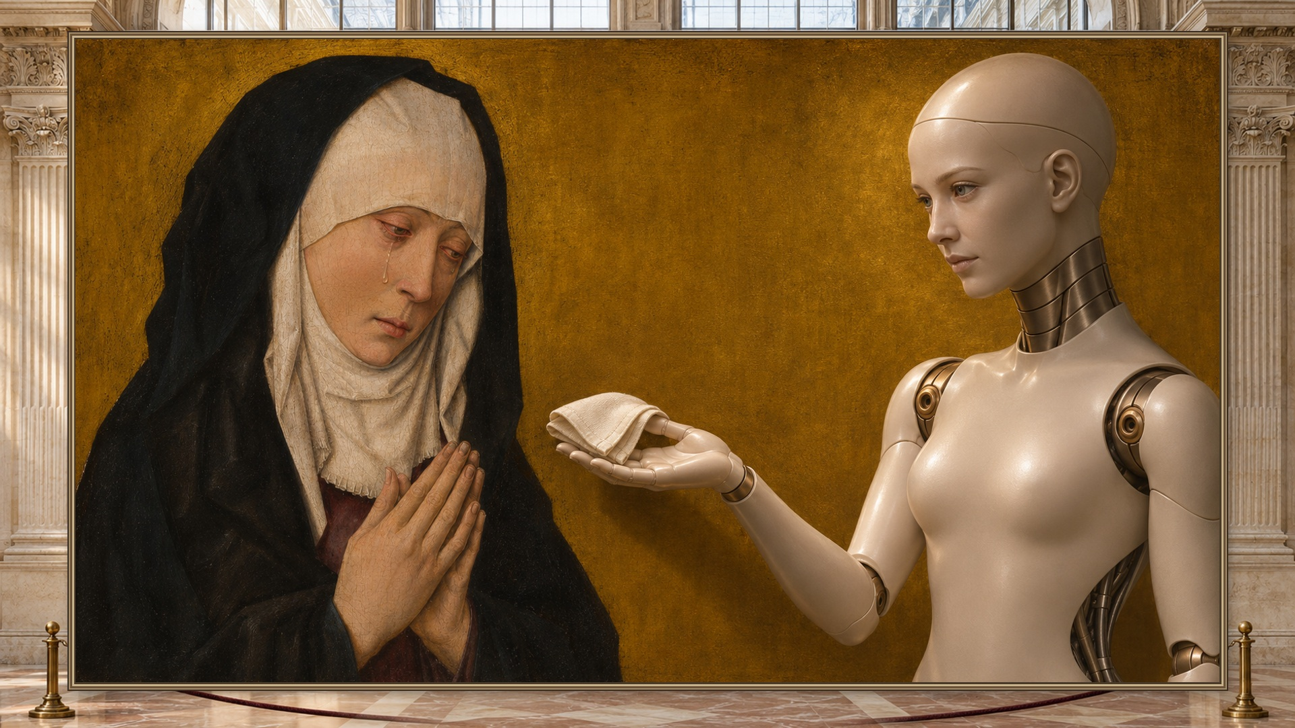
Notes:
Here the cue is quieter. She offers the cloth, then waits.

Slide 8
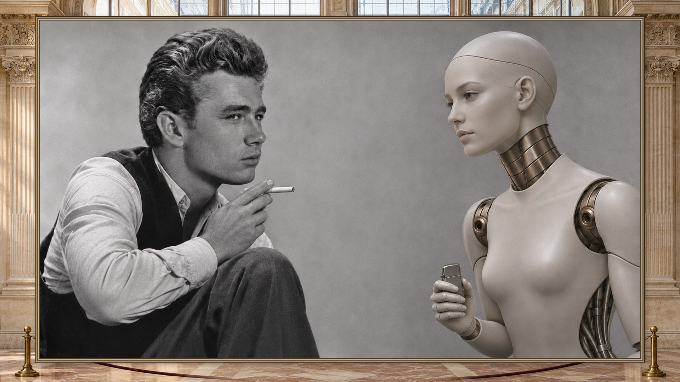
Notes:
A raised cigarette. A light. Same timing, different setting.

Slide 9
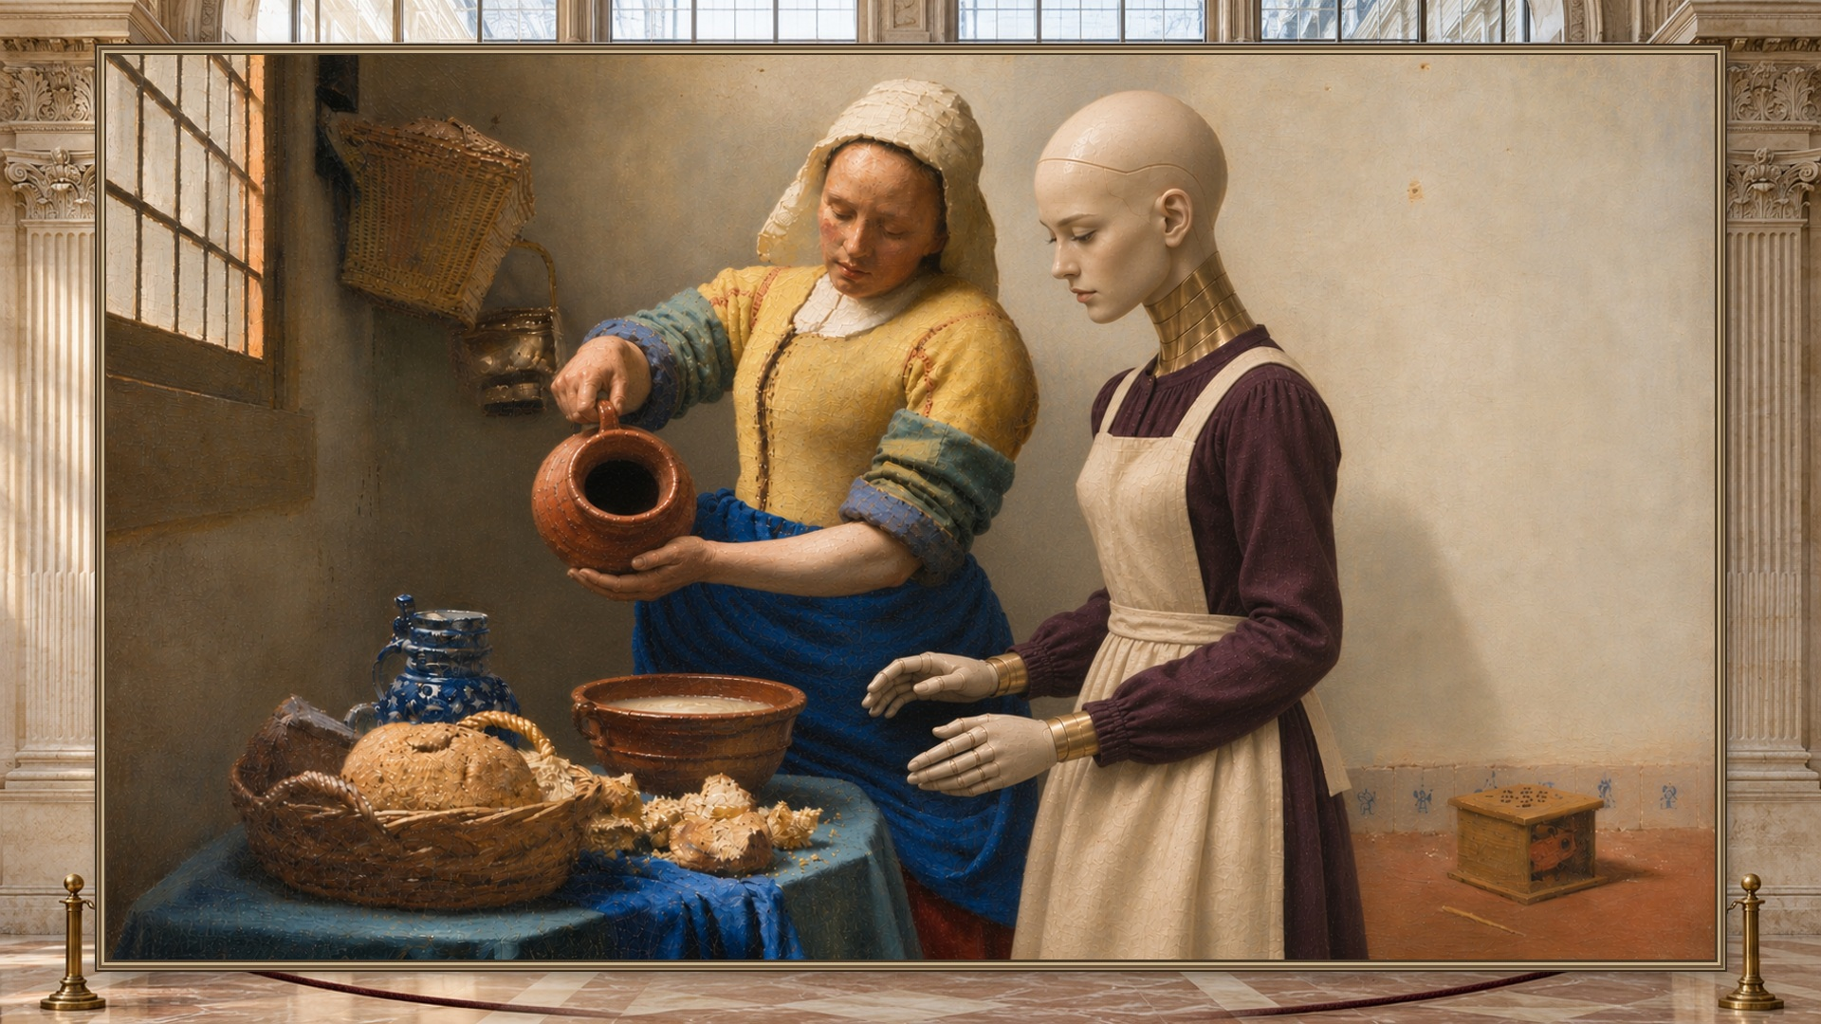
Notes:
The jug tips. Emmy steadies the bowl. Those are the kinds of complementary actions we want to rehearse.

Slide 10
One person can enter a virtual rehearsal.
Webcam / Quest
Unreal + Isaac
A real participant
Shared scene and physics-based rehearsal
Dream → simulated robots
Codex → physical robot
Notes:
A person can join through a webcam or headset. Their motion drives an avatar in Unreal, alongside a virtual robot. Isaac is the physics layer in our design. Separate rooms can run at once, so different people can rehearse the same interaction without waiting for a physical arm.

Slide 11
10
84
Dream attempts in 170 seconds
parallel simulations
16 s
Right arm: pick, lift, place, park
Notes:
We ran ten simulations in parallel. Dream made 84 attempts in 170 seconds. On the physical station, the right arm picked up a cylinder, lifted it, placed it and parked in 16 seconds using replayed waypoints. Those are separate runs. [If a repeat trial is locked, show it live and shorten this narration.]

Slide 12
It held the cup. It missed the target.
Cup-hold rehearsal
Notes:
One simulated cup stayed in the gripper but stopped below its target height. We counted that as a miss. A robot can hold on and still fall short of what the person asked it to do.

Slide 13
What comes
next
Assist intent
Invite more people
Test transfer
Notes:
Next we’ll let a person interrupt a rehearsal and rate the response. Then we’ll try the same cue on the shared station and measure whether the arm responds at the right moment.

Slide 14
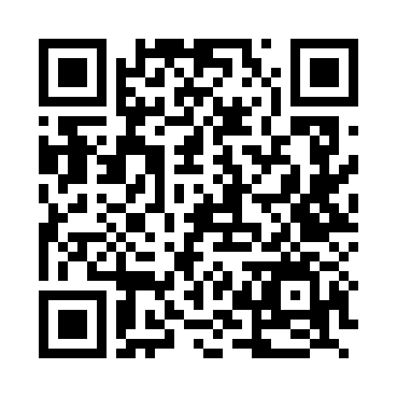
Bring a human
into rehearsal.
Explore the project
Notes:
Bring us one task that takes two people. Let’s rehearse what the robot should do on the other side.

Slide 15
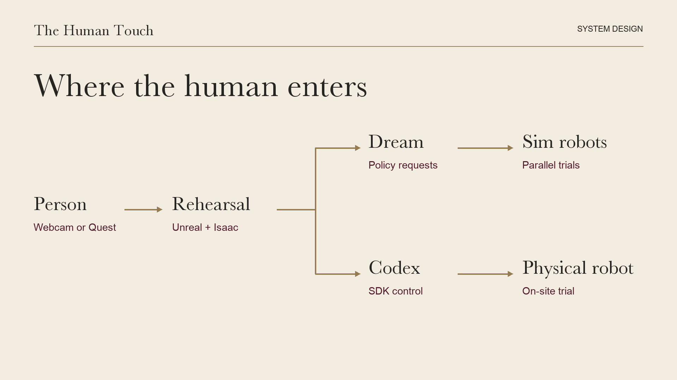
Notes:
Use for the two-minute Q&A or five-minute finals. Explain the robot-view camera and tracked human skeleton, then the separate Dream simulation and physical SDK paths. Label integrated Isaac streaming, feedback-based training and transfer as planned until demonstrated.

Slide 16
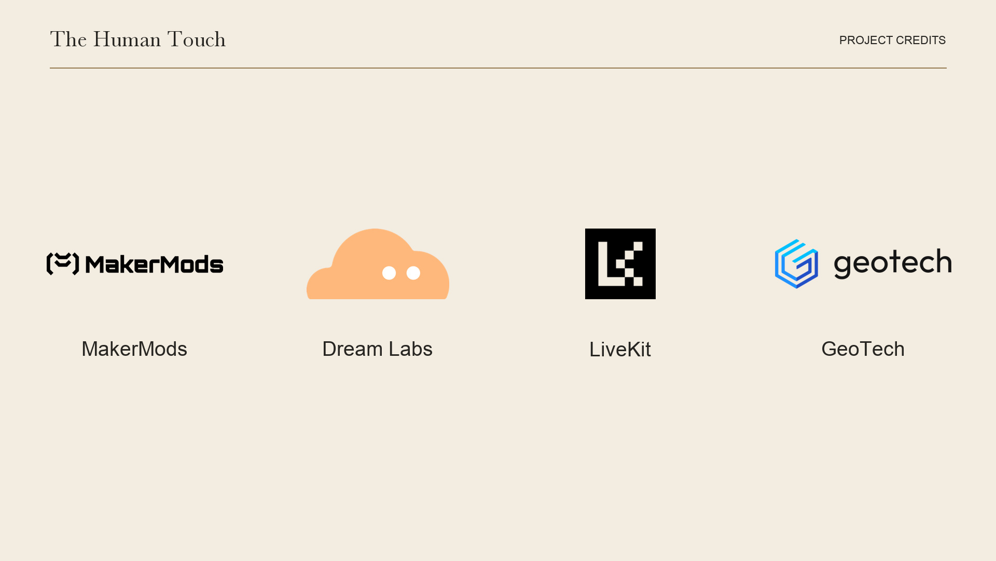
Notes:
MakerMods supplied the station platform. Dream Labs supplied the policy used in simulation. LiveKit is the voice and streaming option. Disclose any extra Quest or camera hardware; show what runs on the shared station alone.

